Slide 1
Deep RL for 3D Navigation
DS-551 Final Project
Prof. Navid Dadkhah Terani
Hongchao Hu, Niyati Gohil

Slide 2
DQN / DDQN
Two value-based baselines for fair comparison
Both use CNN policy with 4-frame stacking to address partial observability
Both are implemented with Stable-Baselines3 DQN in this project (no custom algorithm code)
Shared tuning: learning rate 1e-4, replay buffer 100,000, batch size 32, gamma 0.99
Update setup: target update interval 1,000, train frequency 4, learning starts 10,000
Exploration schedule: epsilon 1.0 to 0.05 over 30% of training
Training budget: 1,000,000 timesteps per model
Evaluation every 25,000 steps, with periodic checkpoints every 250,000 steps

Slide 3
PPO
Policy-based approach using the same CNN + 4-frame stacking input for fair comparison
Uses rollout-based policy optimization, which is robust for sparse-reward navigation
Tuned with: learning rate 2.5e-4, n_steps 256, batch size 512, epochs 4
Stability settings: gamma 0.99, GAE lambda 0.97, clip range 0.2, entropy coef 0.01
Parallel data collection with 8 environments to improve sample diversity
Training budget: 1,000,000 timesteps
Evaluated every 25,000 steps, with periodic checkpoints every 100,000 steps
Best checkpoint is selected from evaluation logs

Slide 4
Training Setup
Episode horizon fixed at 250 steps to match the assignment requirement
Sparse reward design: zero reward during normal movement, positive reward only when the agent reaches the red box
Partial observability handling: 4-frame stacking for all methods
Consistent preprocessing and reward wrapper across PPO, DQN, and DDQN baseline for fair comparison
Device selection supports CPU/GPU with the same training pipeline structure
Pipeline stages: periodic checkpointing, checkpoint-based evaluation, final model evaluation, plot generation, and simulation video rendering

Slide 5
Evaluation
Measured three primary metrics: mean return, success rate, and mean steps per episode
Logged periodic evaluation checkpoints (eval_freq set to 25,000; equivalent to larger timestep intervals for vectorized PPO).
Saved best-performing checkpoint automatically based on mean evaluation reward
Generated a unified summary file and plots for cross-method comparison
Used final saved model evaluations and checkpoint trends to analyze relative performance

Slide 6
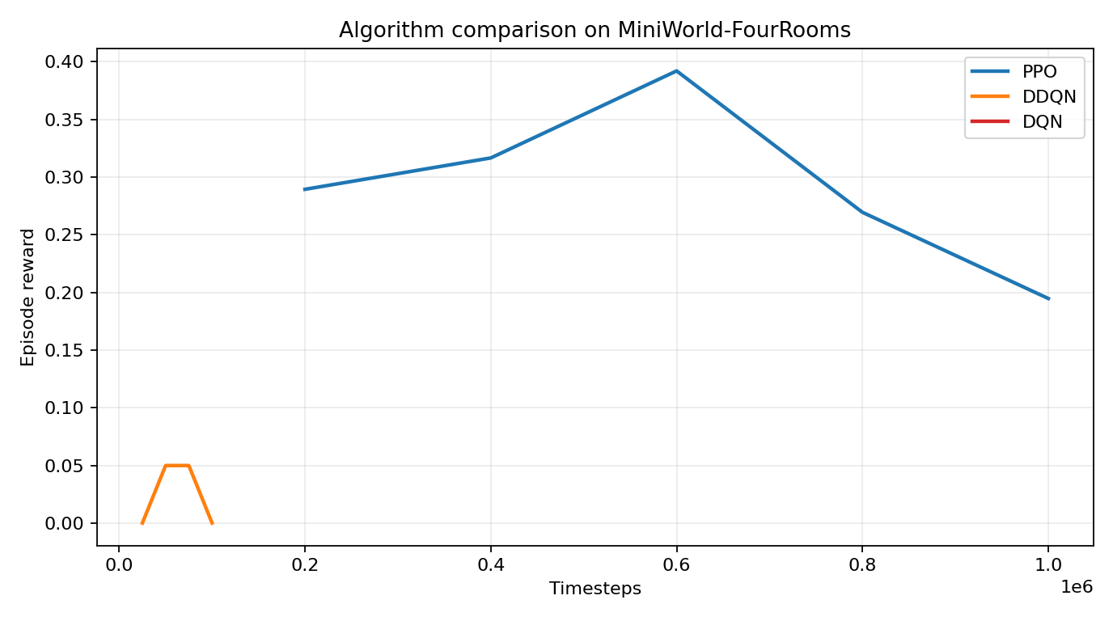
Results

Slide 7
Final Performance
DQN/DDQN vs. PPO
Metric | DQN | DDQN | PPO
Mean Return | 0.0331 | 0.0000 | 0.3544
Success Rate | 3.33% | 0.00% | 36.67%
Mean Steps | 241.93 | 250.00 | 173.63

Slide 8

Agent in Action

Slide 9
Thank you!

